Slide 1




FANTOMCODE ‘25
24-Hour National Level Hackathon
Team Name: Radiance
Team Members 1:Dhruva Prashant Patavardhan
Team Member 2: Billava Srujan Macha
Team Member 3:Chintada Siddardha Chaitanya

Slide 2
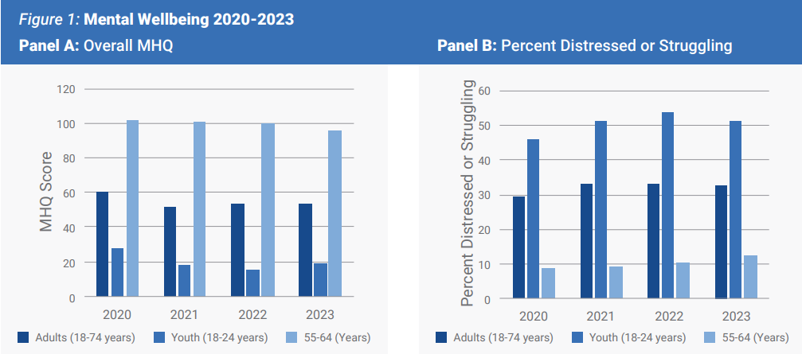
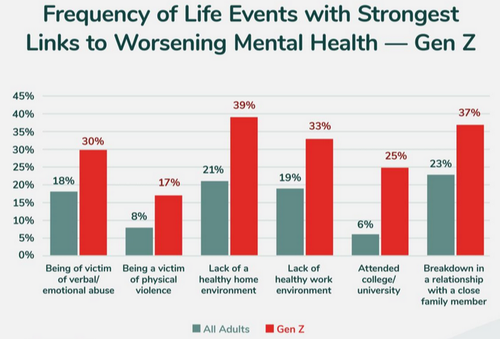
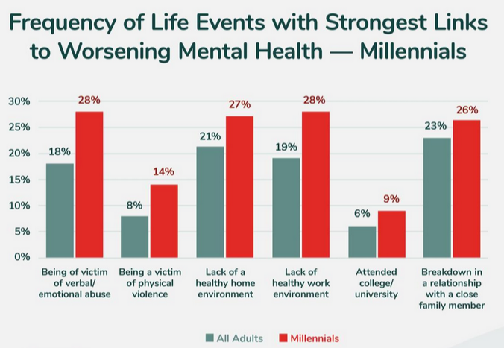
PROBLEM STATEMENT
Growing mental health crisis due to lack of accessible therapy and support.
Challenges in therapy selection, medication adherence, and community support.
Need for real-time professional guidance and relaxation techniques.
Fig 1
https://sapienlabs.org/wp-content/uploads/2023/11/Mental-State-of-India-Report-October-2023.pdf
Fig 2
Fig 3
https://www.statista.com/chart/27749/discord-popularity-by-country-gcs/

Slide 3
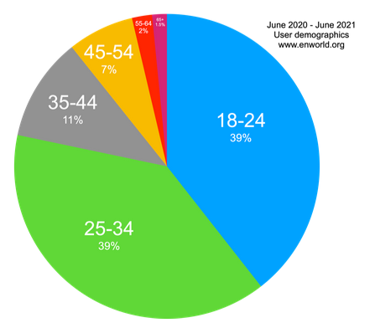
Discord and ML based Mental Health Platform
Discord user share by age
Web-Based Smart Therapy Matching platform
Discord-Based Mental Health Support & Therapy Sessions
Discord bots for assisting user and therapist.(Book session, check products, Check bookings for therapist and many more)
Therapy Sessions on Discord: Secure voice/video channels for professional-led therapy and group support sessions.
Safe Discord communities for peer support, making mental health discussions more accessible.
Anonymous Chat Community
AI Chatbot & Speech-to-text transcription(For therapy session)
Fig 4: https://www.enworld.org/threads/another-year-of-en-world-demographics.680725/

Slide 4
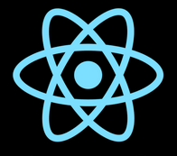

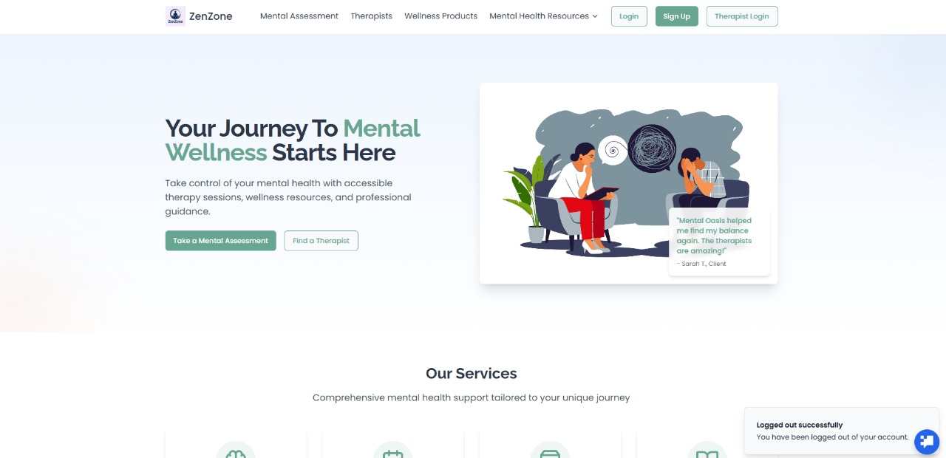
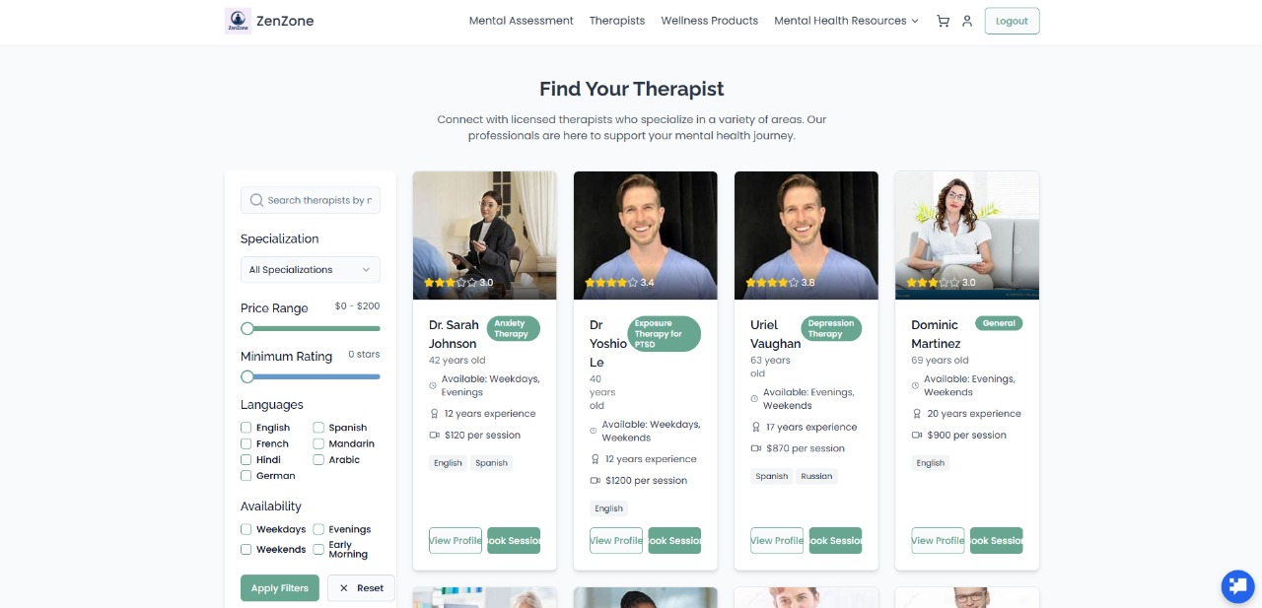
TECHNICAL APPROACH
Tech Stack
1. Web App:
Frontend: React.js, DigitalOcean, Tailwind CSS
Backend: Node.js, Express.js
Database: MongoDB
Hosting: PM2
Auth & Real-time: JWT Auth, Socket.io
2. Machine Learning Models:
NLP: BERT, GPT (therapy matching)
Recommendation: TensorFlow, Scikit-learn (collaborative filtering)
3. AI Chatbot (Web & Discord):
Frameworks: Langchain, Rasa, OpenAI API
Integration: Discord.js,
4. Speech-to-Text Transcription:
Libraries: Whisper AI

Slide 5
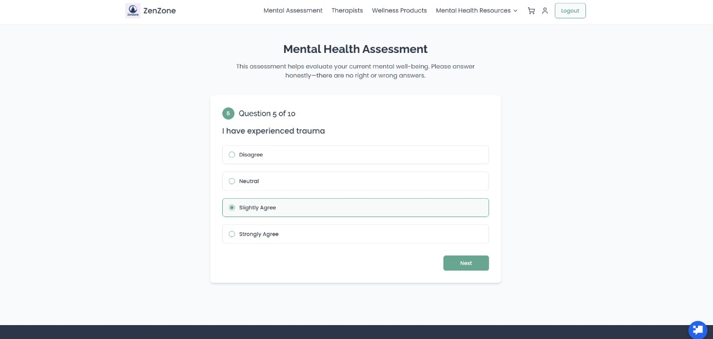
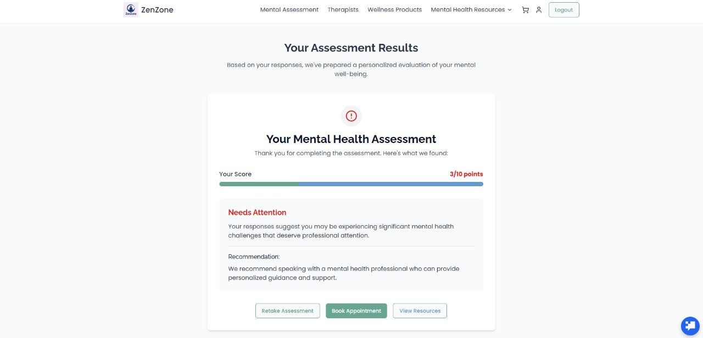
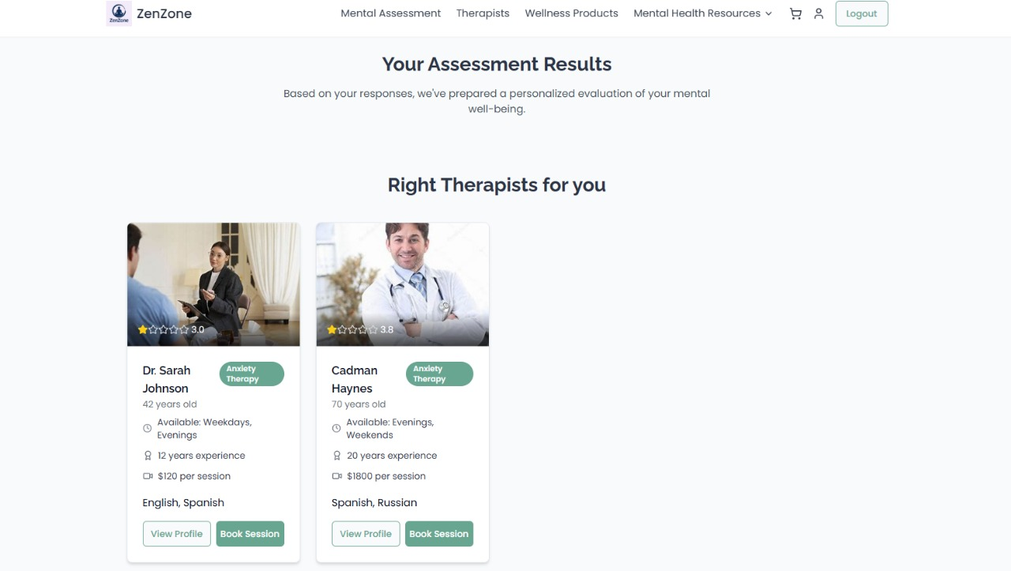
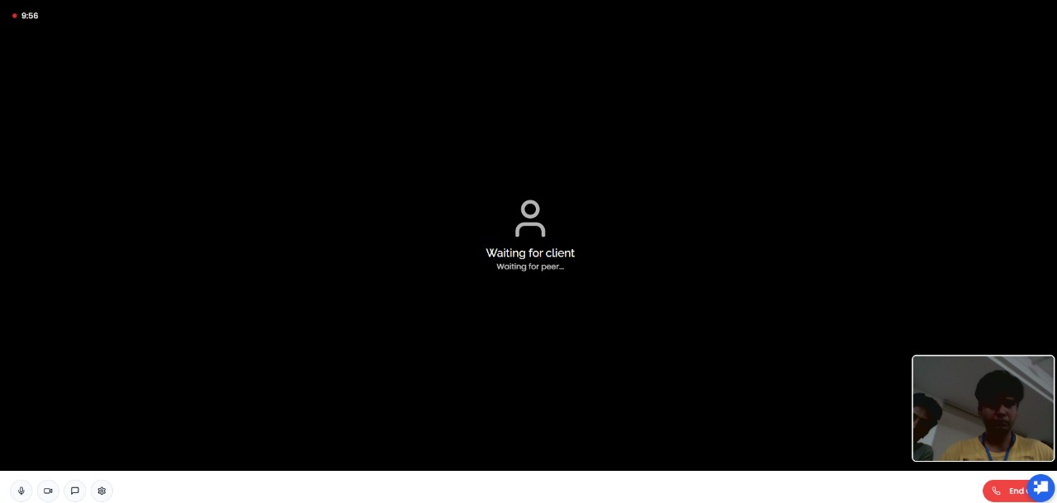
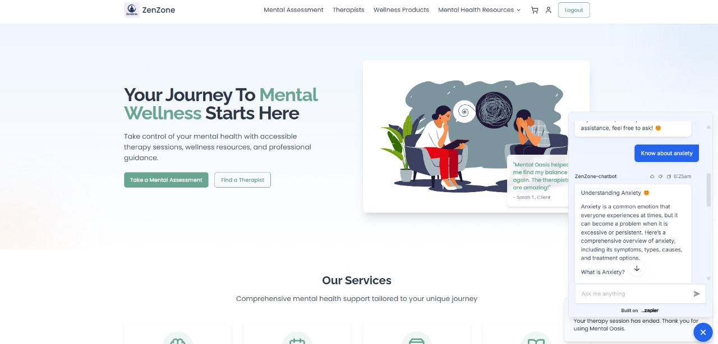
USER JOURNEY(WebApp)
Click here to visit our website

Slide 6
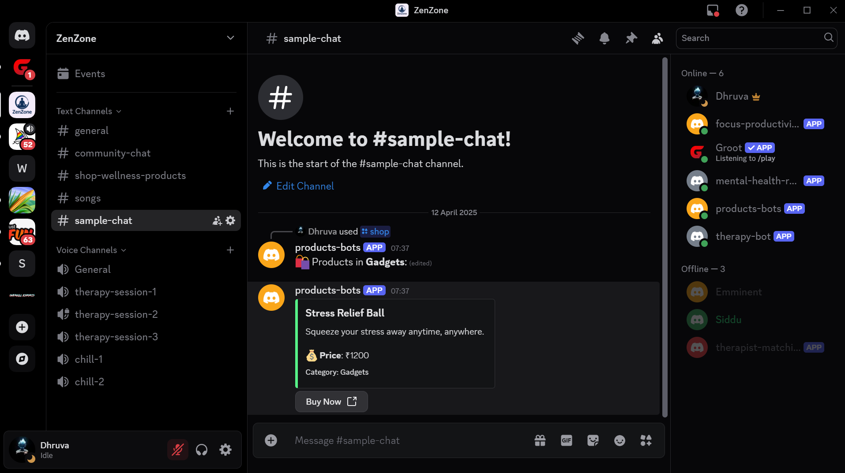
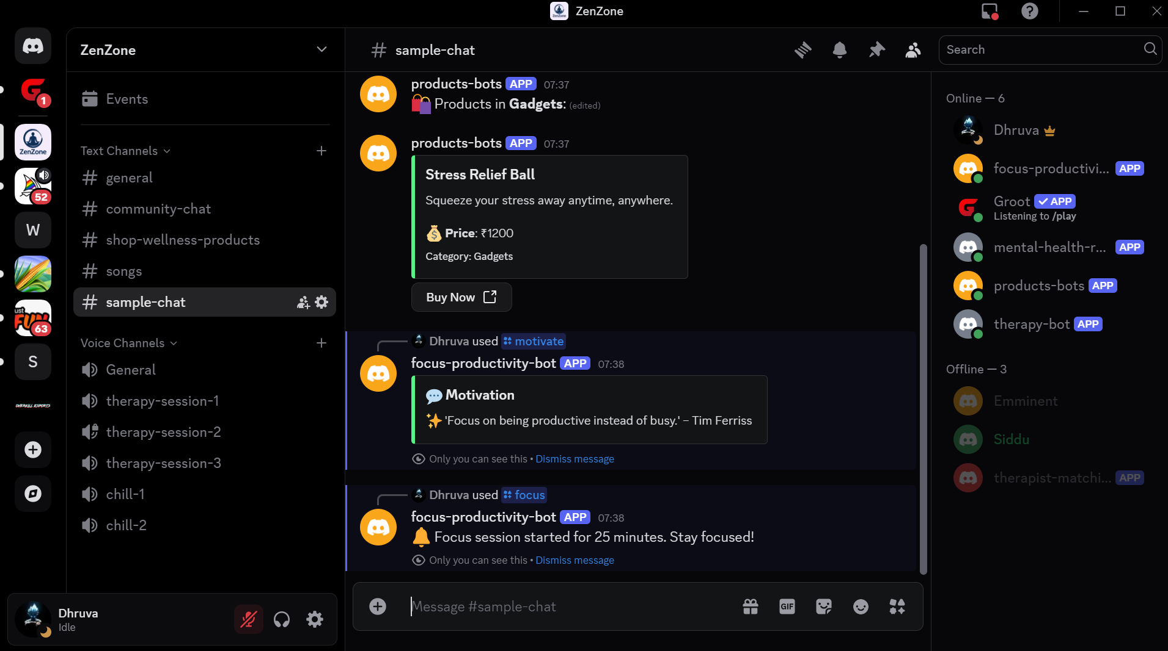
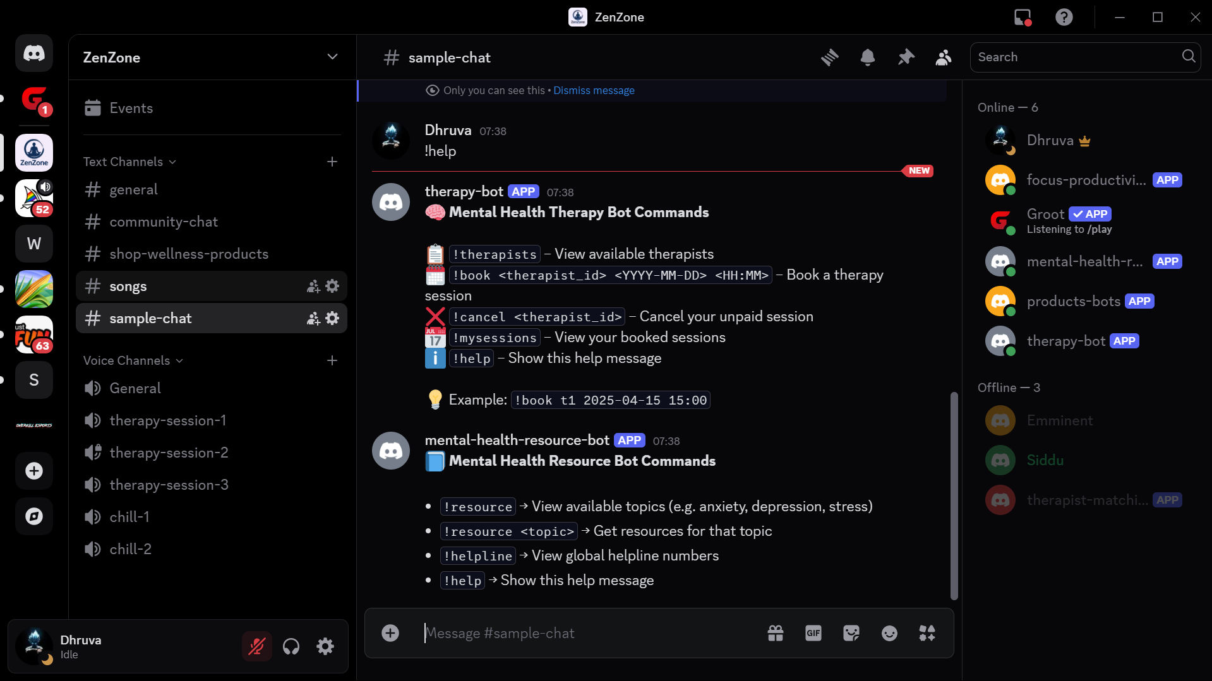
USER JOURNEY(Discord)
Click here to visit our Discord Server

Slide 7
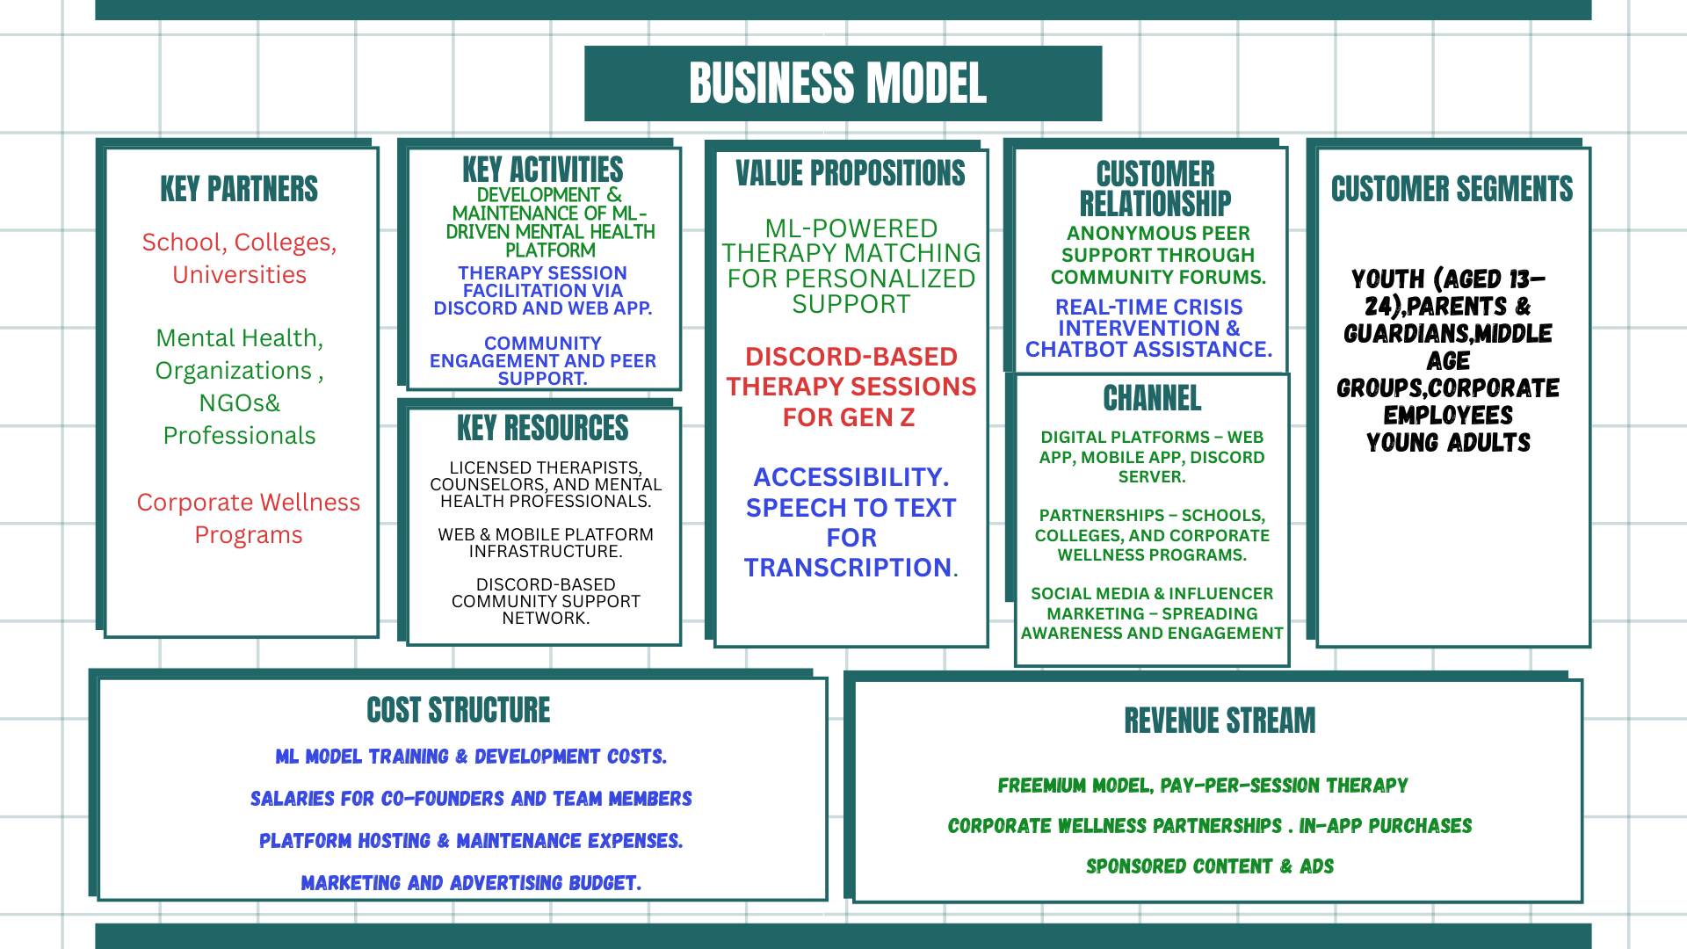
Business Model

